Slide 1
Headlines and developments in genomic sequencing technologies (2023)
Wellcome Advanced Courses NGS Bioinformatics
Santiago de Chile, January 2023
Dr. Eric T. Dawson
Notes:
15-20 mins
Add to GitHub (make a new section for updates / news items)

Slide 2
2023: genomics becomes cheaper, faster, easier
Genomes are now regularly <$1000 - Illumina’s original patents expire; dozens of companies enter the short-read sequencing space
Accuracy of long-read sequencing passes that of short read for SNPs / SVs even as costs drop
Workflow languages make it easy to develop and use pipelines
GPUs and FPGAs are widespread and reduce analysis time / cost
Notes:
Put logos of new sequencing companies
Put

Slide 3
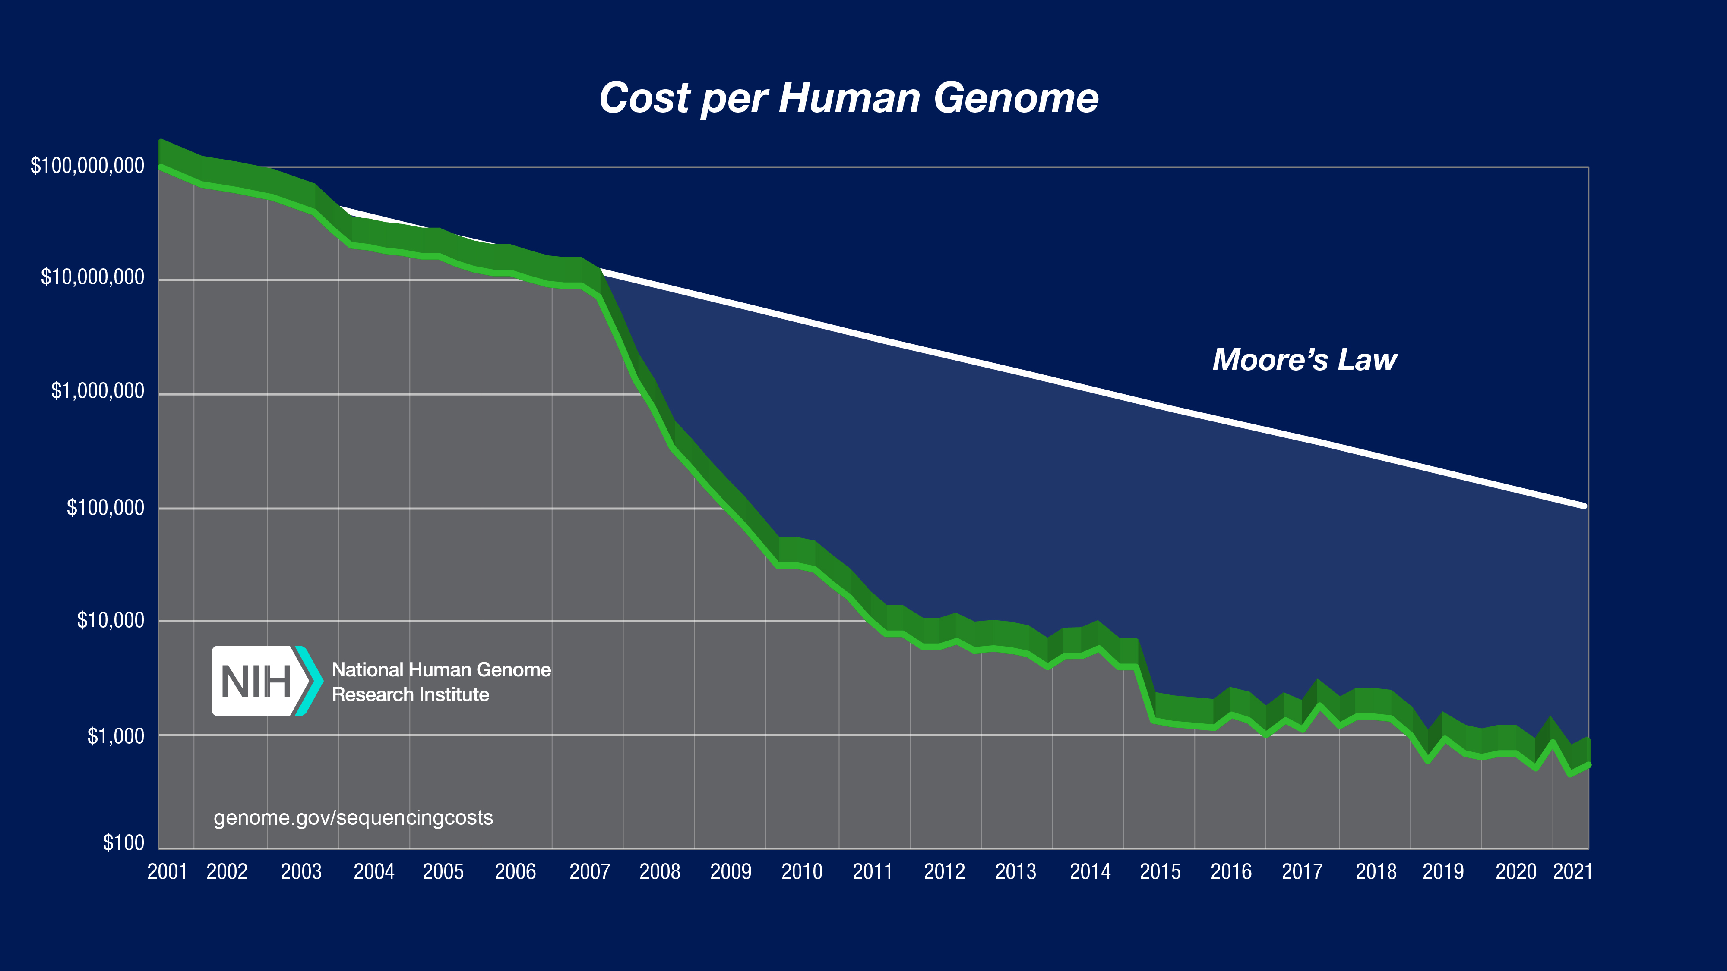
2023: Year of the $100 Genome
2023: $100 Genome

Slide 4
An explosion in short- and long- read platforms under $1000 per 30X WGS human genome
Short Read
Illumina ($200 30x WGS): NovaSeqX ($200/ 30x wgs); Infinity long read; DRAGEN Updates
Singular ($1000): G4 (reduced multiplexing + massive data)
MGI ($1000): DNBSeq
Element ($200) – Ativi
Ultima Genomics ($100) – UG 100; Custom DeepVariant + others tools
Others: ThermoFisher, Genapsys, Roche
Long Read
Oxford Nanopore ($1000) – P2 and P2 Solo, Duplex Sequencing, <$1000 30x WGS on multiple systems
Pacific Biosciences ($1000) – RevIO (<$1000 30X WGS), DeepConsensus, Onso short read platform
Great, up-to-date list of sequencers:
https://docs.google.com/spreadsheets/d/1GMMfhyLK0-q8XkIo3YxlWaZA5vVMuhU1kg41g4xLkXc/edit#gid=1569422585

Slide 5
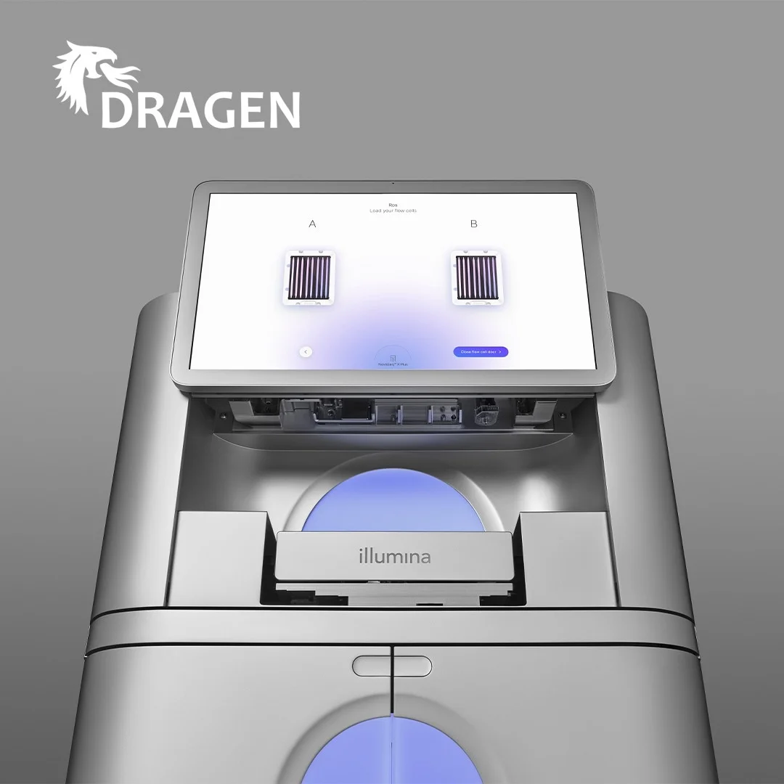
Illumina
NovaSeqX
Up to 20,000 $200 genomes per year
Lower consumable cost
DRAGEN available on-sequencer – direct sample-to-VCF output
DRAGEN continues to improve
DRAGEN – a special chip that makes BWA / GATK analysis much faster
Integration with GATK-DRAGEN
DRAGMAP + graph genome + ML leads to best-in-class variant calling
Available on AWS
~30 mins FASTQ->VCF
Synthetic long reads coming 2023
Based off of Longas acquisition, brings Illumina-level accuracy to multi-kilobase reads (exact length not yet specified) using variation graphs
Notes:
ADD PICTURE OF NOVASEQ X PLUS

Slide 6
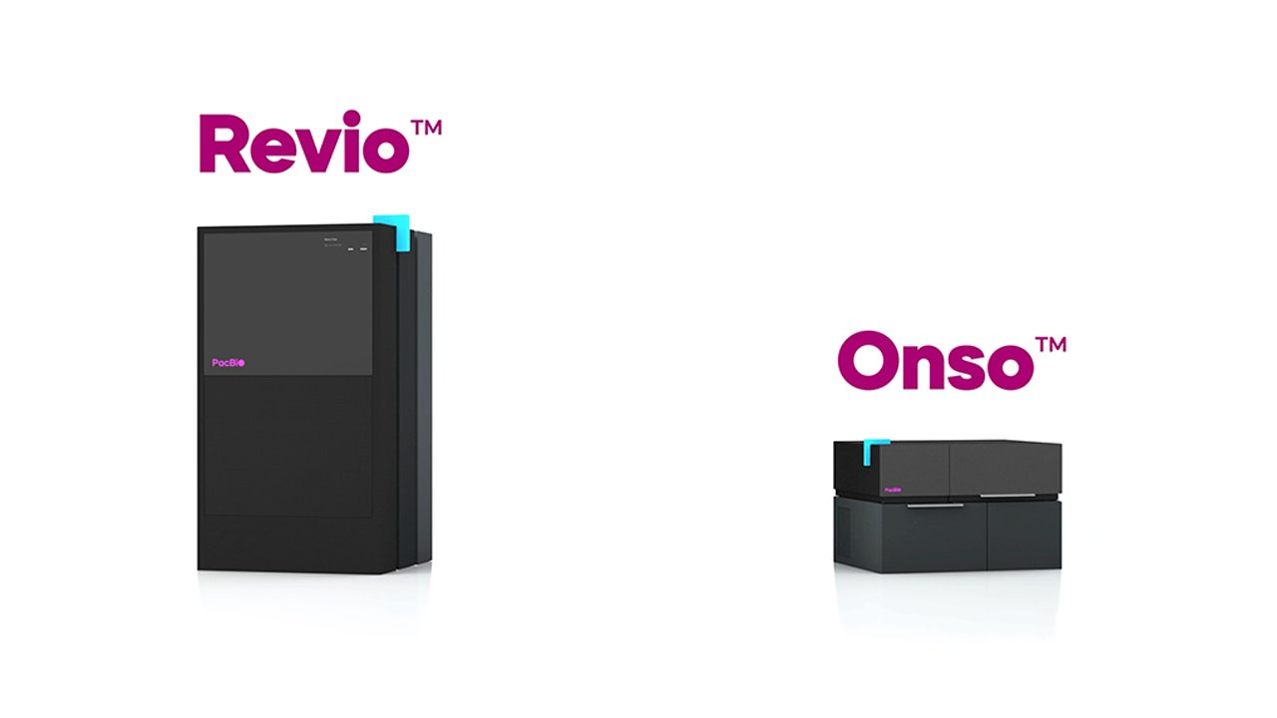
PacBio
RevIO
new instrument with onboard GPUs, <$1000 genome, high throughput, >99.95% (Q33) accuracy @ 20kb+
DeepConsensus
Even higher accuracy than HiFi using Deep Learning (better SNP accuracy than Illumina; highest accuracy reads). Very powerful for assembly and SV detection.
Onso
Omniome Acquisition brings new “short” read sequencing tech in 2H 2023. Unknown accuracy / length still.

Slide 7
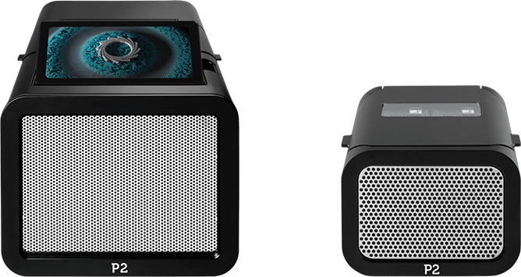
Oxford Nanopore
P2 + P2 Solo
For $10,000, enables 30X WGS genomes (+ zero-capital model)
Massive throughput in small device – 2 PromethION flowcells + built-in GPU for basecalling
Dorado basecaller brings faster, more accurate sequencing
SNP accuracy now better than for Illumina reads (>99%); read accuracy 96-99%
High performance and able to call base modifications
Duplex sequencing, short fragment mode enable new workflows
Duplex: >99.99% accuracy by reading both template and complement strands of DNA
Short Fragement Mode
EPI2ME switches to NextFlow, runs natively on tower
Pre-built, reproducible analysis pipelines on- or near-sequencer

Slide 8
Focus on: Oxford Nanopore Analysis
EPI2ME: Prebuilt workflows (in NextFlow) available on the Promethion tower – just bring your data and run from the graphical user interface
Possible to bring your own workflows
Workflows also available for compute elsewhere

Slide 9
Analyzing Oxford Nanopore Data Effectively
Coverage guidelines
Assembly: 60X
Variant calling: 20-40X
Clinic: 60X or more still recommended if just ONT
Assembly Workflow
Alignment
(minimap2)
Assembly
Annotation
Basecalling
Variant Calling Workflow
Mapping
(minimap2)
SNP / indels
SVs
(sniffles)
Annotation

Slide 10
Workflows for ONT Data
EPI2ME: official ONT-supported workflows
Basecalling and mapping
Pre-built workflows and tutorials in NextFlow including assembly, alignment, variant calling, RNA, metagenomics
Many more community workflows (including GPU accelerated ones)
Recommendations:
Alignment
Minimap2
Assembly:
Minimap + miniASM (microbial)
Flye (diverse organisms)
Shasta (human)
Wtdbg2 (fast)
Variant calling:
Medaka
Claire3
DeepVariant (incl. GPU-accel)
Sniffles2 (SVs)

Slide 11


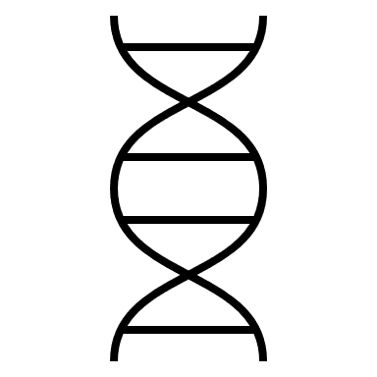


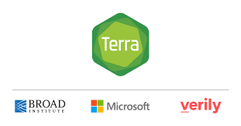


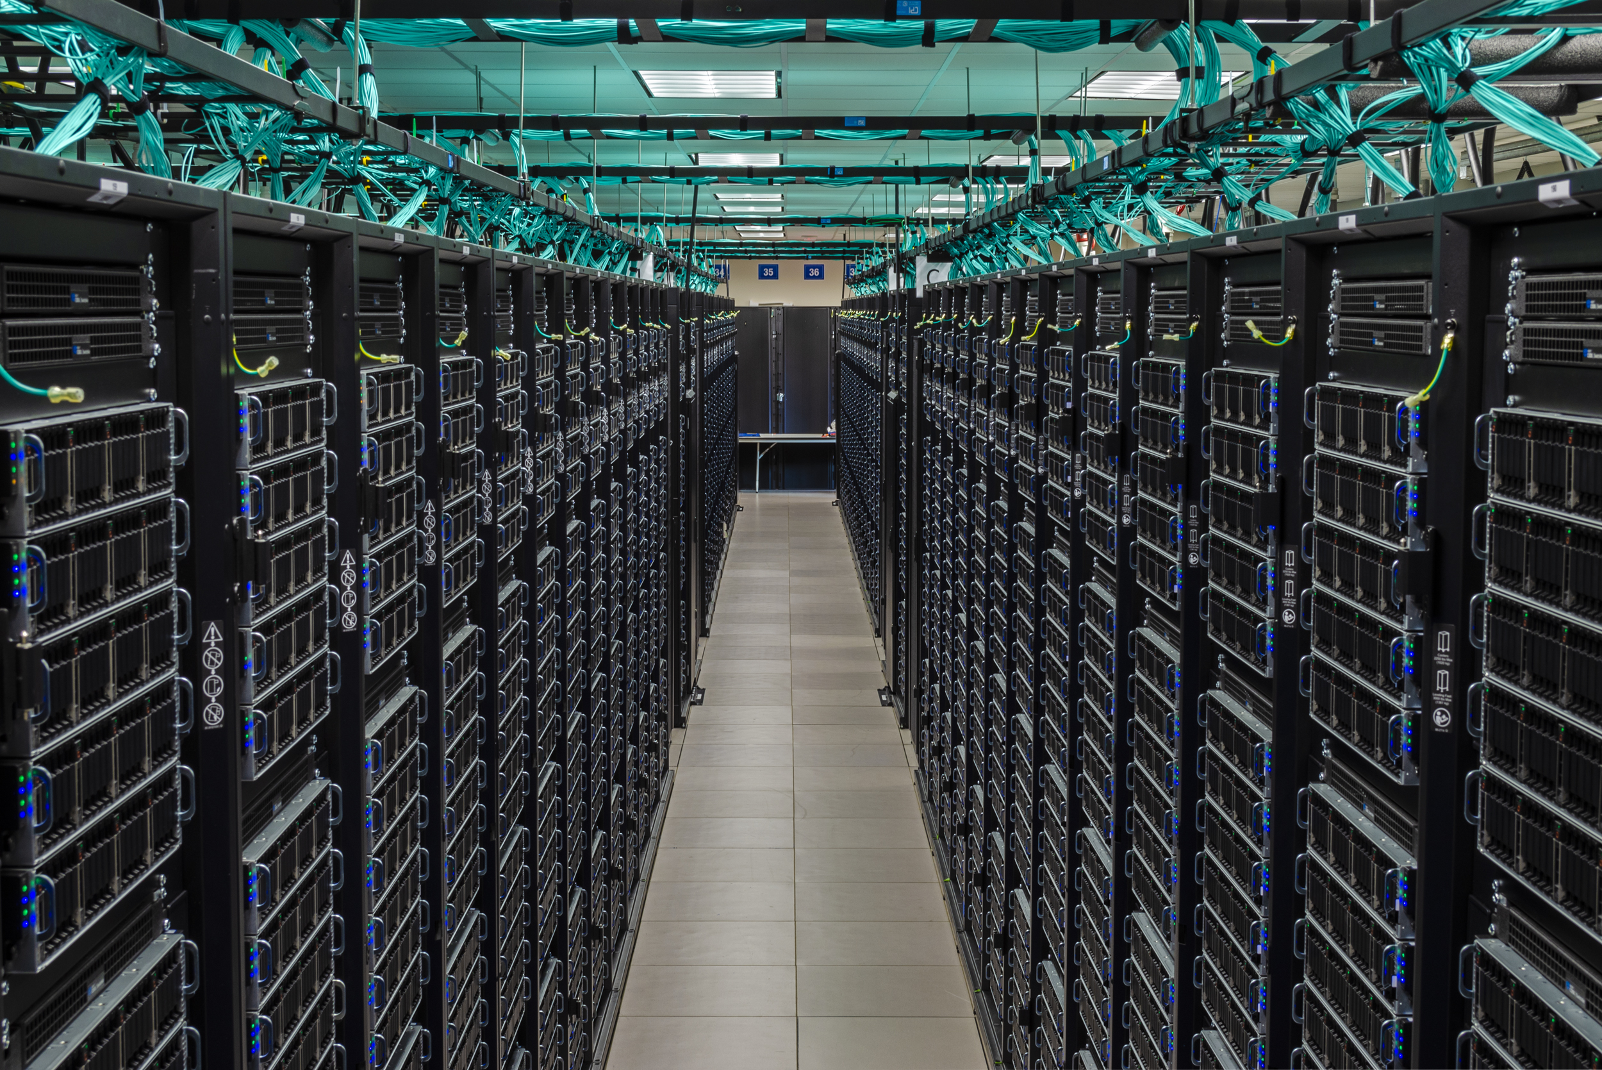

Workflow languages make running and sharing analyses easier
Your inputs
Workflow Script

Slide 12
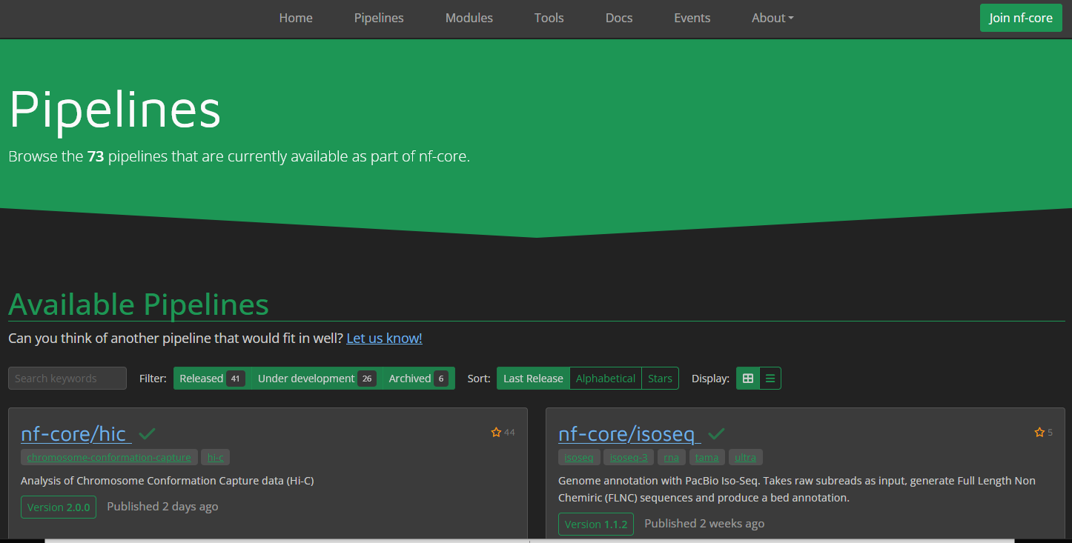
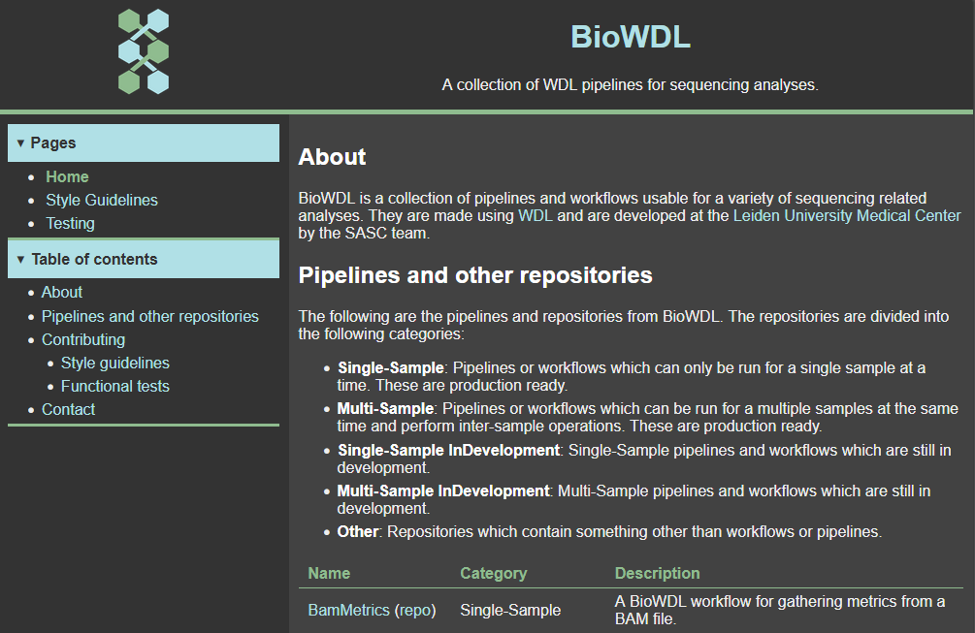
Libraries of pre-built workflows for analysis
NextFlow NF-Core https://nf-co.re/
BioWDL https://biowdl.github.io/

Slide 13
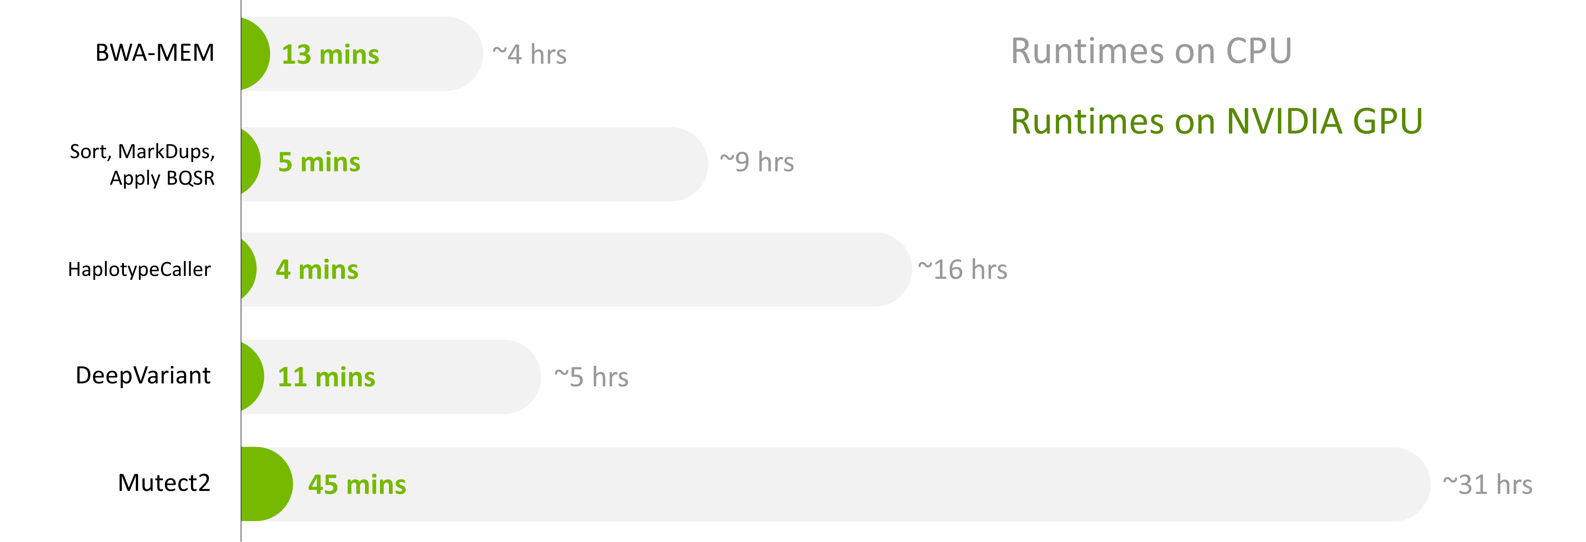
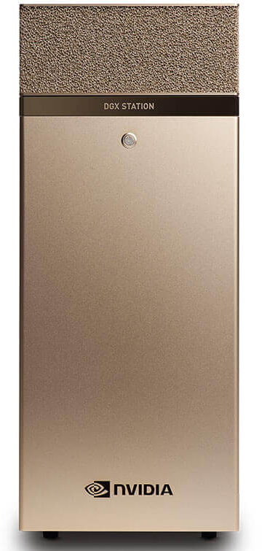
GPUs and FPGAs massively accelerate analysis
Up to 80X reduction in processing time for alignment / variant calling using NVIDIA GPUs + Software;
similar numbers for DRAGEN

Slide 14
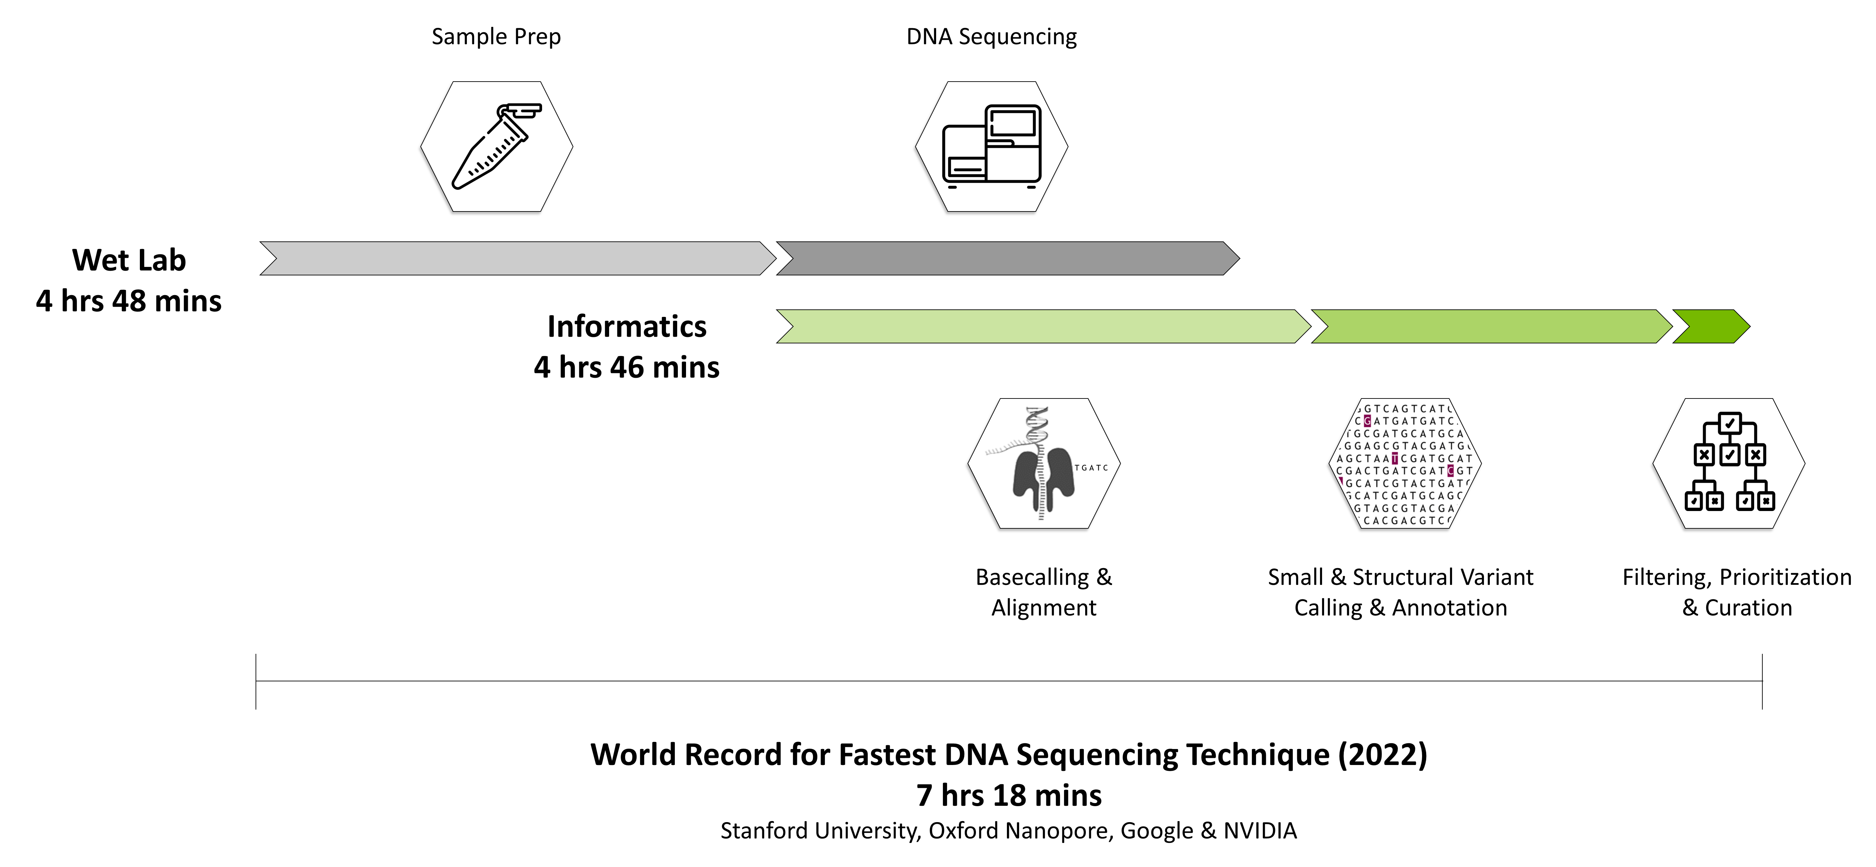
GPUs and Real-Time ONT sequencing enable world-record blood-to-diagnosis run
Notes:
Demonstrates how real-time long read sequencing and accelerated analysis tools can significantly reduce analysis times

Slide 15
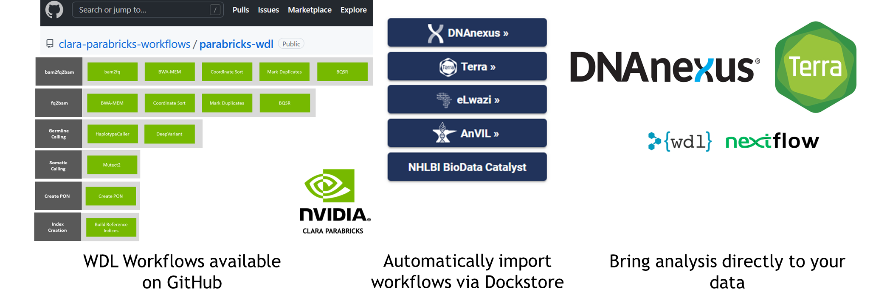
GPUs are now easy to use via workflows and the cloud
Workflows are automatically updated on Dockstore platform
Run your workflow locally, on a compute cluster, or on the cloud.

Slide 16
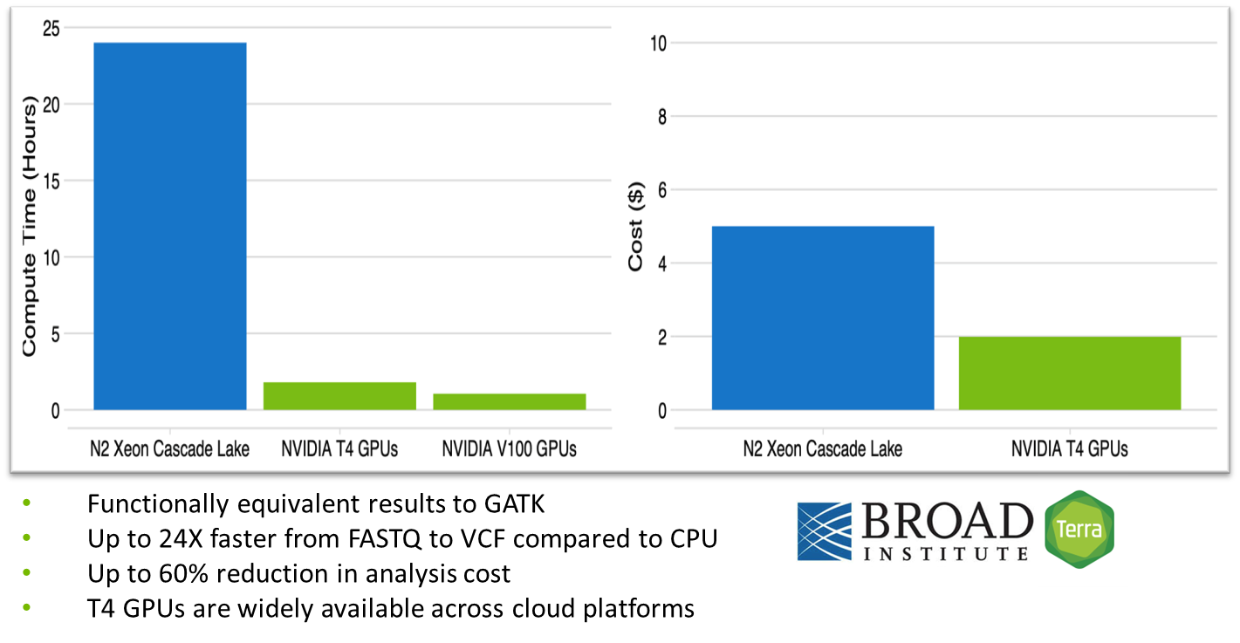
GPUs enable faster, cheaper analysis

Slide 17
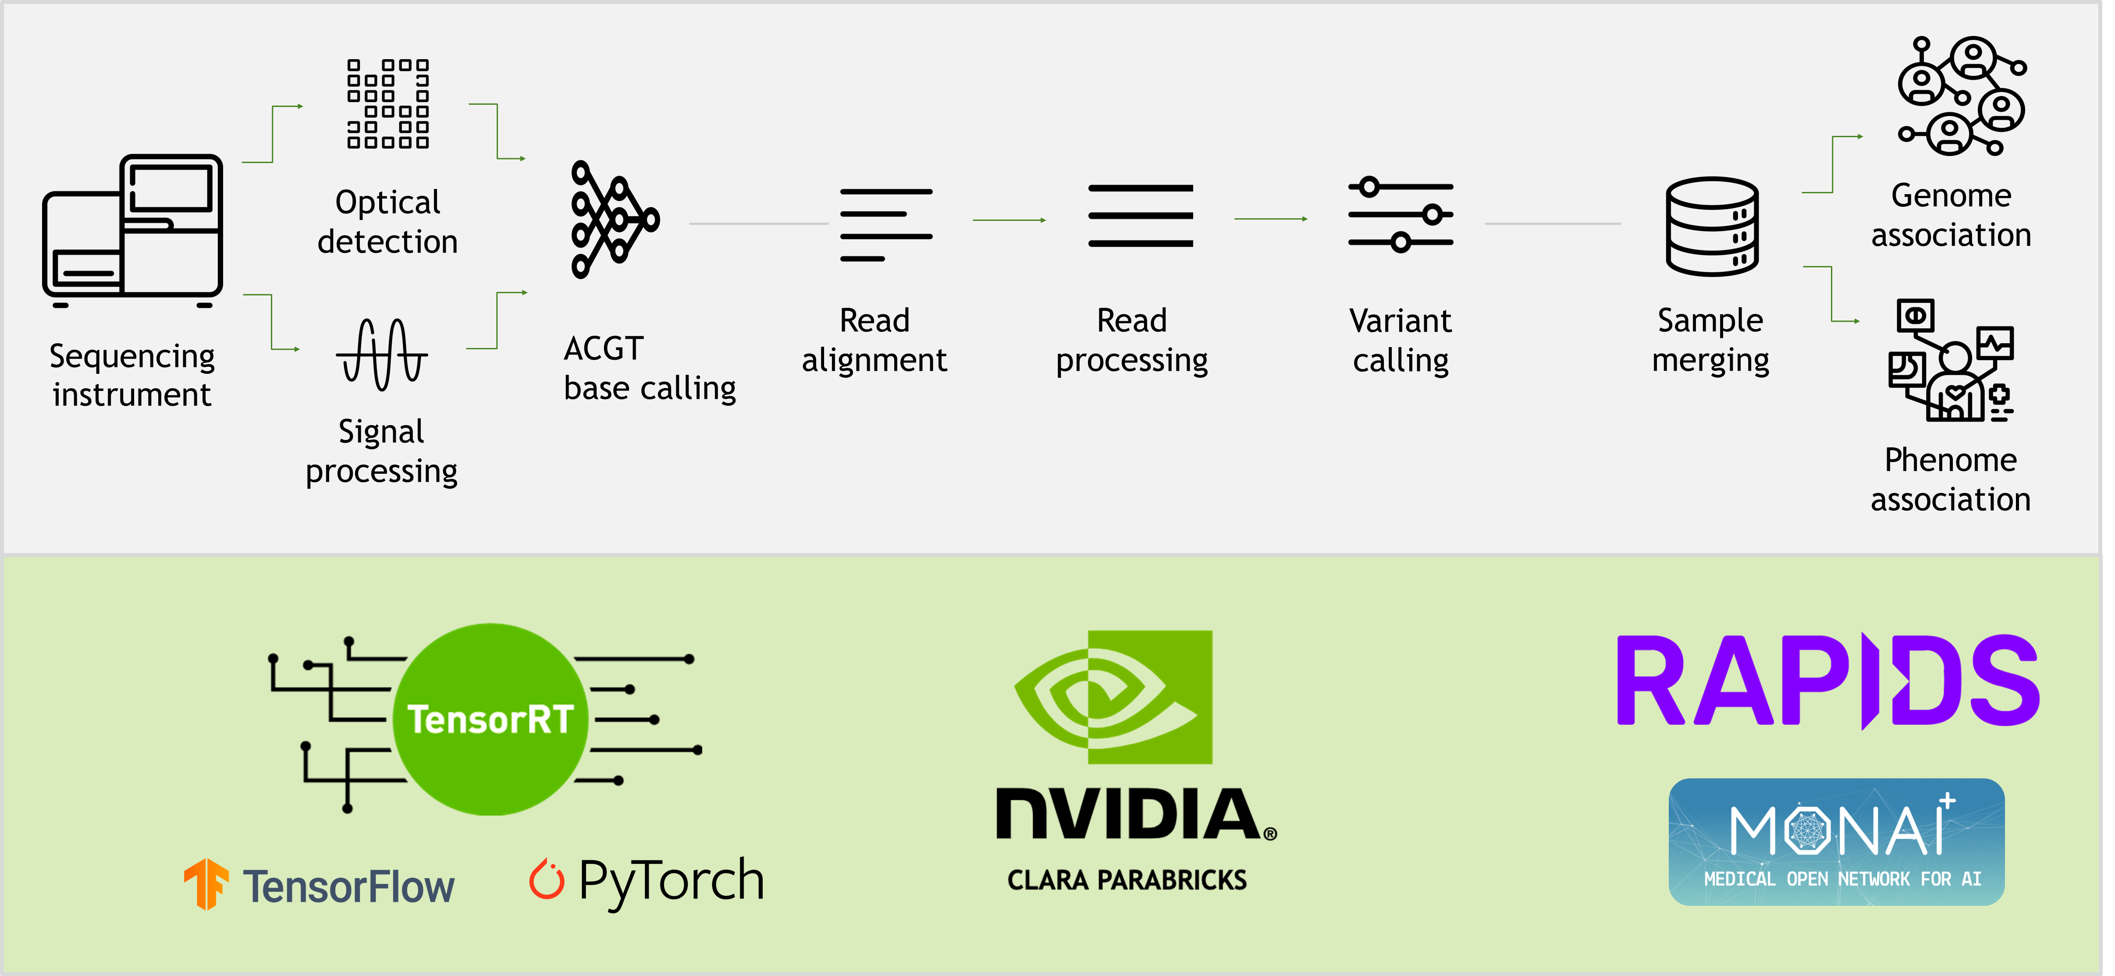
GPUs/FPGAs are now integrated at every stage of genomic workflow

Slide 18
Summary
Whole genome sequencing regularly under $1000, even for long reads, with less multiplexing
Long read quality approximately identical to short read (for SNP calling; still an indel gap)
Data volume significantly higher than last generation of instruments
Improvements in postprocessing (faster, more accurate)
Workflows are now common, publicly shared, and backed by large communities
Acceleration is routine (essential)
Analysis is now as expensive as sequencing without acceleration
DRAGEN / Clara Parabricks for short reads
GPU basecalling (Dorado)
GPUs / FPGAs on-instrument (PromethION, RevIO, NovaSeqX, Singular G4)

Slide 19
This is a blank slide.

Slide 20
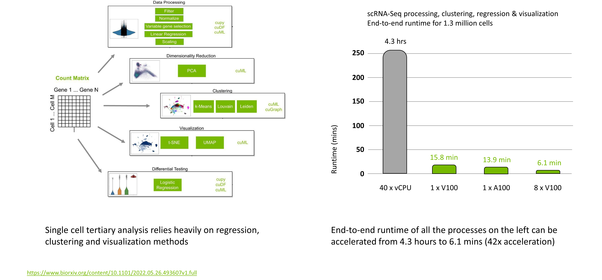

Slide 21
ONT assembly
Many assemblers available
Note: most available in EPI2ME / nextflow (no need to create your own workflow from scratch)
Minimap2 + miniASM
Good for small genomes; fast
Flye
Good contiguity; can assemble across genome size spectrum; Expensive
Shasta
Good speed-to-contiguity tradeoff; fewer disagreements to reference than Flye / Canu (i.e., more accurate, less contiguous)
Wtdbg2
Generally good assemblies; fast
Canu
Relatively old and slow at this point; still generates most contiguous assemblies from human genomes

Slide 22
ONT basecalling
https://nanoporetech.com/how-it-works/basecalling

